Slide 1
Chapter 5
List
General Linear Lists
Objectives
Upon completion you will be able to:
Explain the design, use, and operation of a linear list
Implement a linear list using a linked list structure
Understand the operation of the linear list ADT
Write application programs using the linear list ADT
Design and implement different link-list structures

Slide 2
Figure 3-1

Slide 3
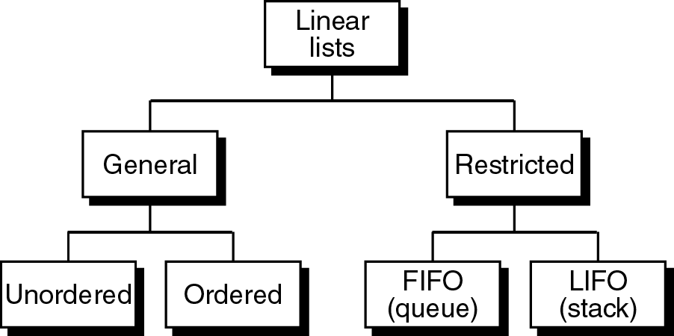
Figure 3-2

Slide 4
General linear lists
A general linear list is a list in which operations can be done anywhere in the list.
The sequential property of a linear list is basic to its definition.Array is the simplest linear list structure.
For simplicity, we refer to general linear lists as lists.

Slide 5
5-1 Basic Operations
We begin with a discussion of the basic list operations. Each operation is developed using before and after figures to show the changes.
Insertion
Deletion
Retrieval
Traversal

Slide 6
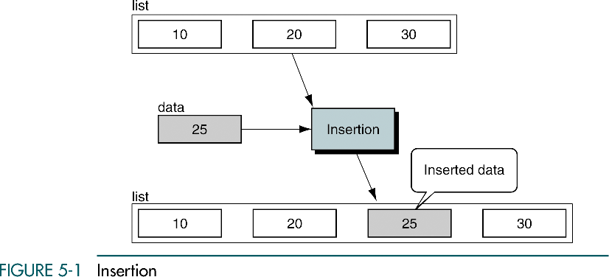
Insertion is used to add a new element to the list

Slide 7
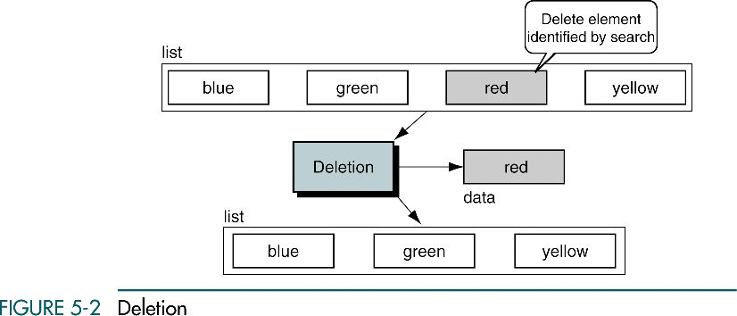
Deletion is used to remove an element from the list.

Slide 8
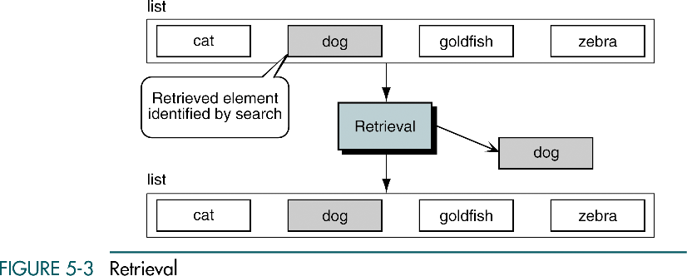
Retrieval is used to get the information related to an element
without changing the structure of the list.

Slide 9
Traversal
List traversal processes each element in a list in sequence.

Slide 10
5-2 Implementation
We begin with a discussion of the data structure required to support a list. We then develop the 10 basic algorithms required to build and use a list. In developing the insertion and deletion algorithms, we use extensive examples to demonstrate the analytical steps used in developing algorithms.
Data Structure
Algorithms

Slide 11
Linked lists
A common data structure used to store similar data in memory,is more flexible & better in performance.
It is an ordered collection of data arranged in logical sequence where each element contains location of next element.each node has at least two parts-data & link fields.
No restriction on the locations of elements.Storing of elements in adjacent locations is not compulsory.
There is no physical relationship between the nodes.so,pointers are there to identify first logical node called the head pointer.

Slide 12
It can grow or shrink in size easily without shifting of nodes.
Insertion & deletion of elements is easy.But we are only limited to sequential searches & cant use binary search because elements are not physically in sequence.
The nodes are called as self referential structures because each instance of structure contains a pointer to another instance of same type.

Slide 13
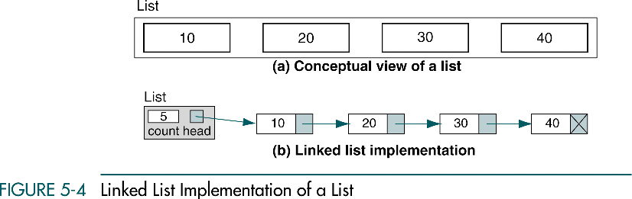

Slide 14
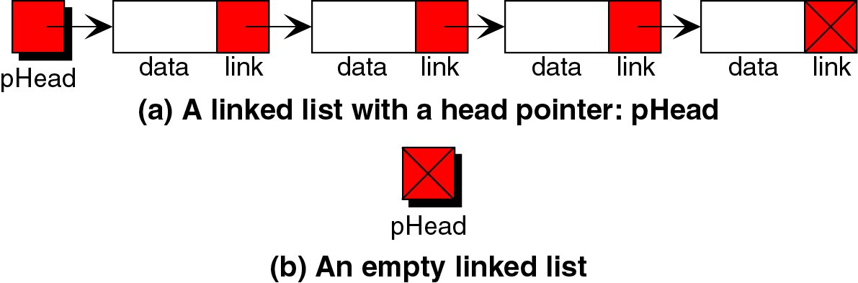
Figure 3-6

Slide 15
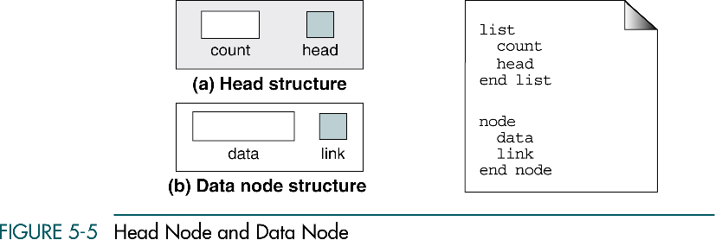

Slide 16
Algorithms
Empty list
Full list
List count
Traverse list
Destroy list
Create list
Insert node
Delete node
List search
Retrieve node

Slide 17


Slide 18
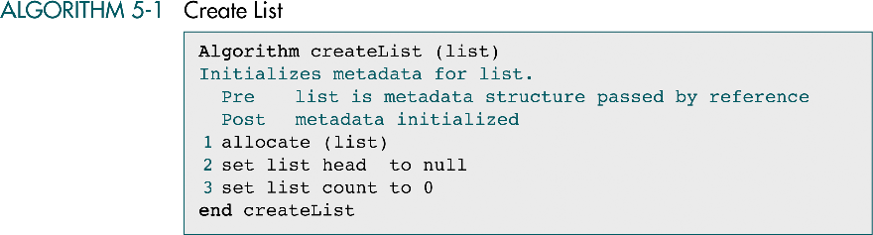

Slide 19
Insert node
Only its logical predecessor is needed.
There are three steps to the insertion:
  Allocate memory for the new node and move data to the node.
  Point the new node to its successor.
  Point the new node’s predecessor to the new node.

Slide 20
Insert node
Insert into empty list
Insert at beginning
Insert in middle
Insert at end

Slide 21
Insert into empty list
Check for head of the list,if it is null the list is initially empty.
Simply assign the list head pointer- the address of new node.
Assign null pointer to the link field of new node.It can be done either by using null pointer constant or by using null pointer in the list head.

Slide 22
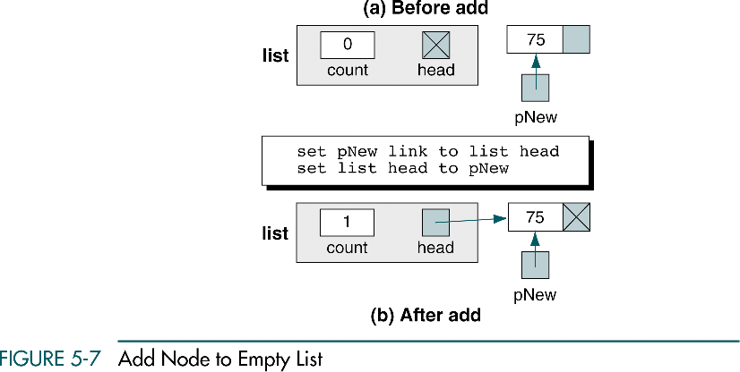

Slide 23
Insert at beginning
Check for the value of predecessor pointer.if it is null,we are inserting at the beginning of the list.
Point the new node to first node of the list.
Set the head pointer point to new first node.

Slide 24
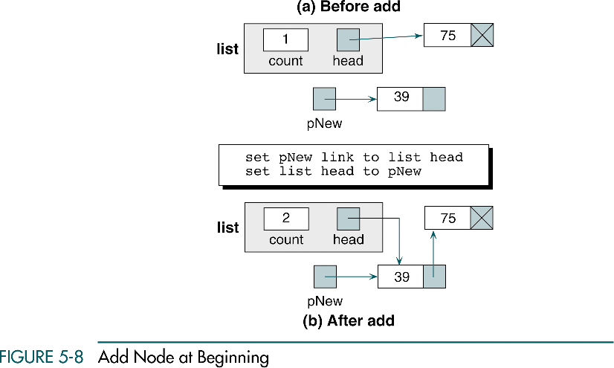

Slide 25
Insert in middle
To insert a node between two nodes,
point the new node to its successor node and point the predecessor node to the new node.
The address of new node’s successor can be found in predecessor’s link field.

Slide 26
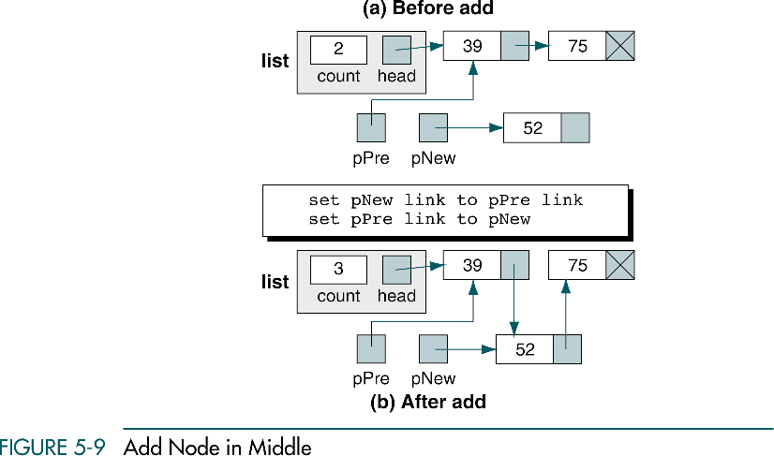

Slide 27
Insert at end
Point the predecessor to the new node.
There is no successor now so we can assign null pointer to link field of new node.

Slide 28
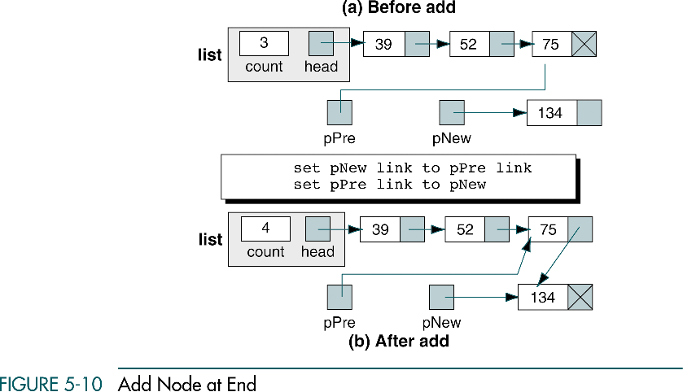

Slide 29
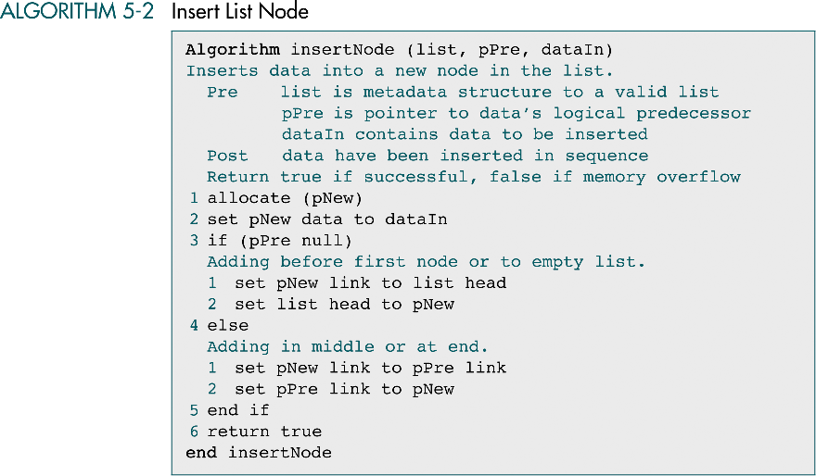

Slide 30
Delete node
Delete first node
Delete general case

Slide 31
Delete first node
Test for predessor value.if it is null,we are deleting the first node.
Reset the head pointer to point to deleted node’s successor.
Release the memory of deleted node to dynamic memory.

Slide 32
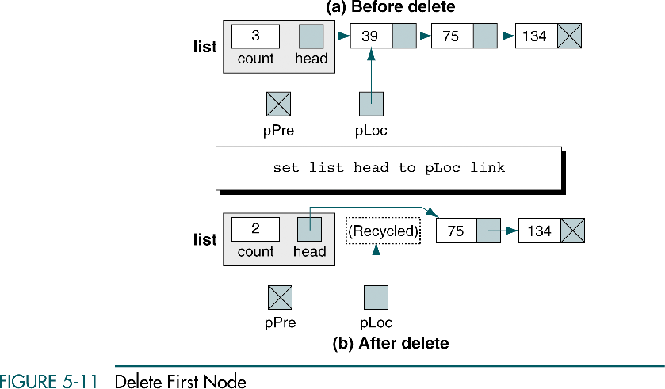

Slide 33
Delete general case
Logic for deletion is same for all cases.
Point the predecessor node to the successor of the node being deleted.
In case of deletion at end ,the null pointer is moved to predecessor’s link field.Now it is the new end node.
Recycle the deleted node after settling of pointers.

Slide 34
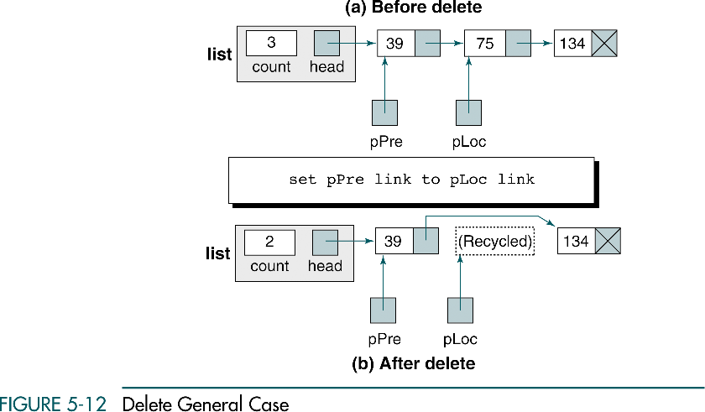

Slide 35
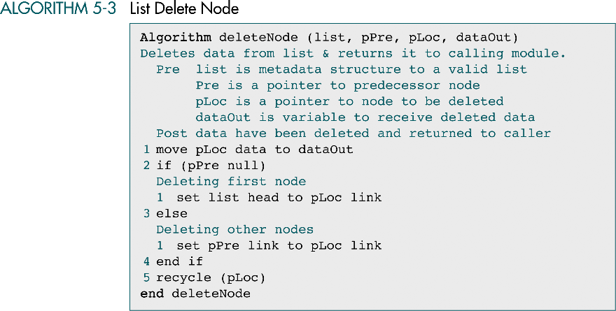

Slide 36
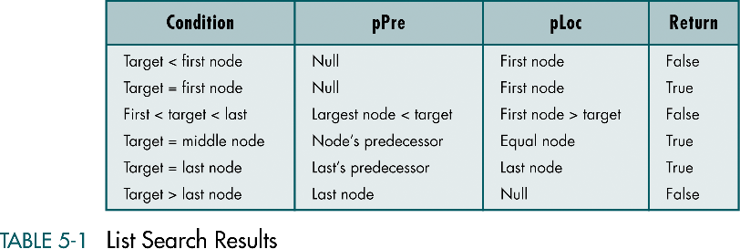

Slide 37
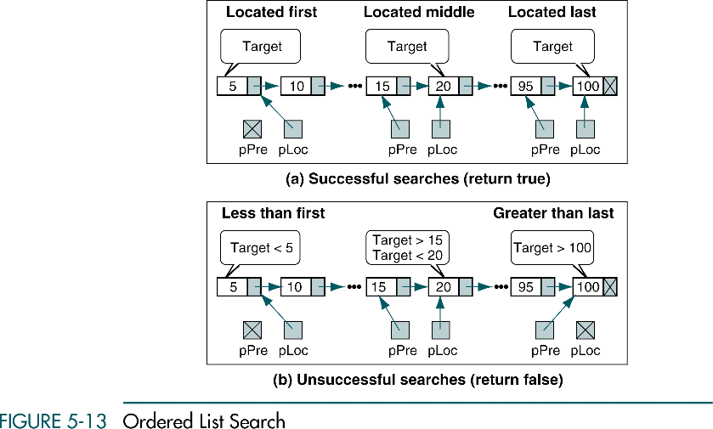

Slide 38
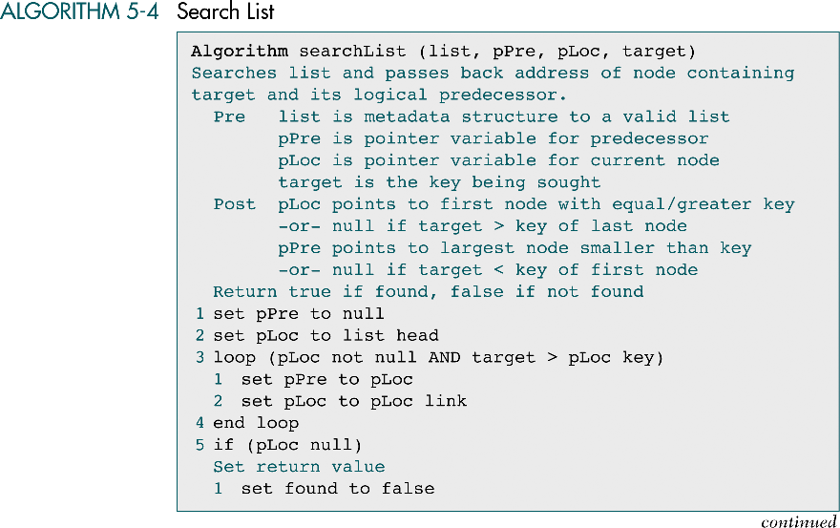

Slide 39
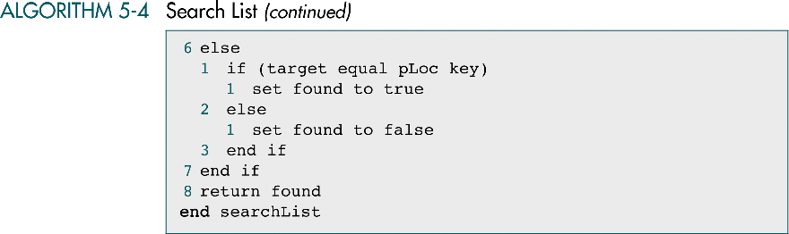

Slide 40
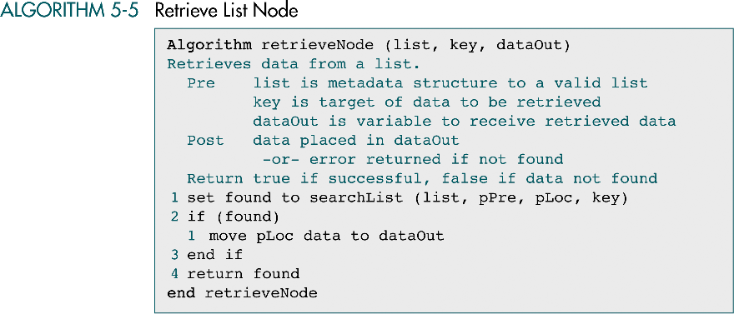

Slide 41
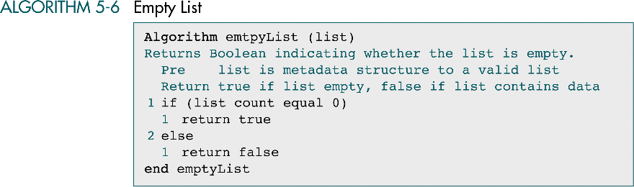

Slide 42
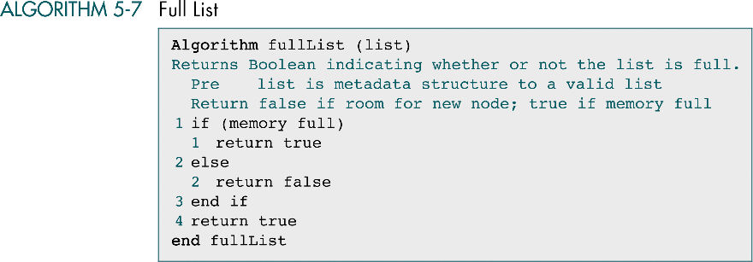

Slide 43
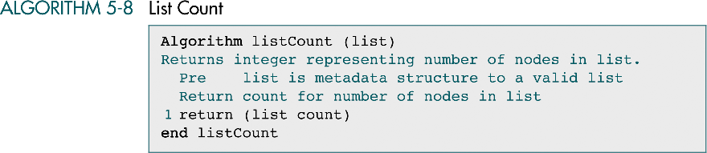

Slide 44
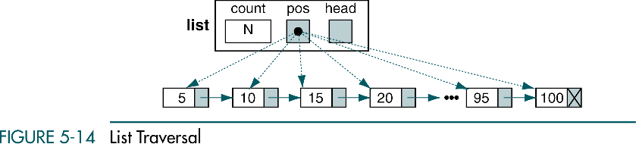

Slide 45
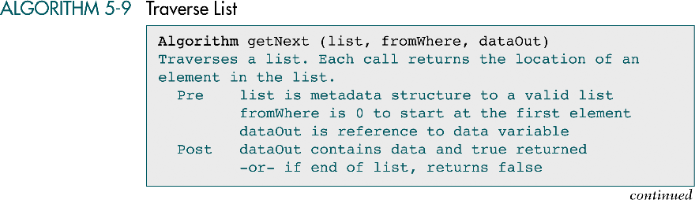

Slide 46
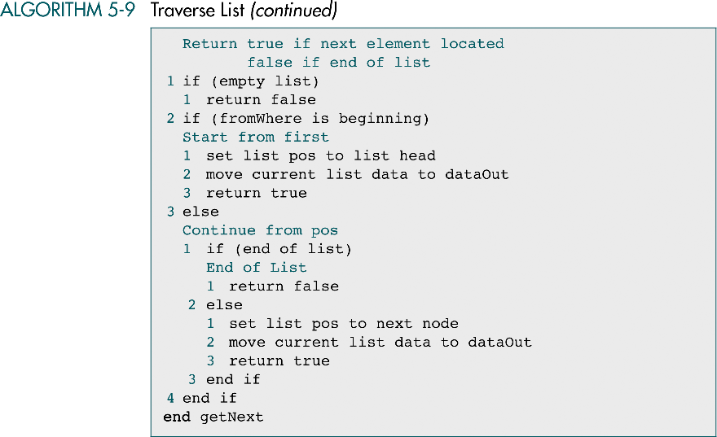

Slide 47


Slide 48
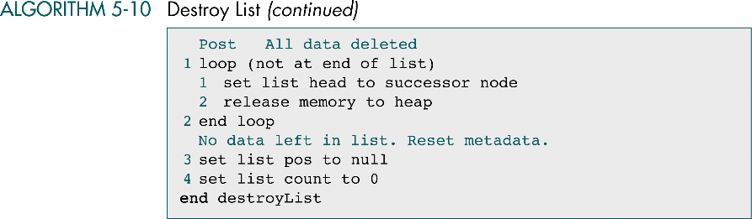

Slide 49
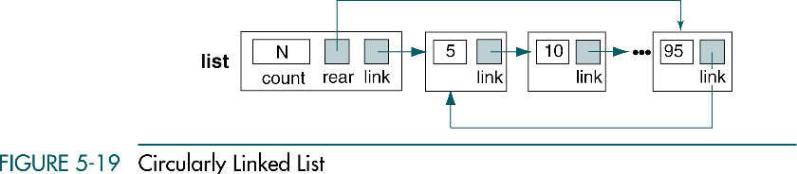

Slide 50
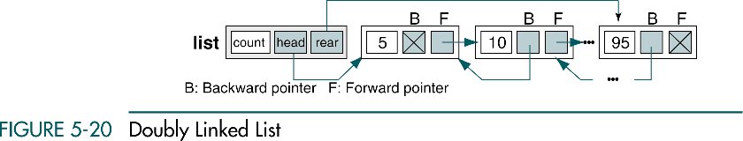

Slide 51
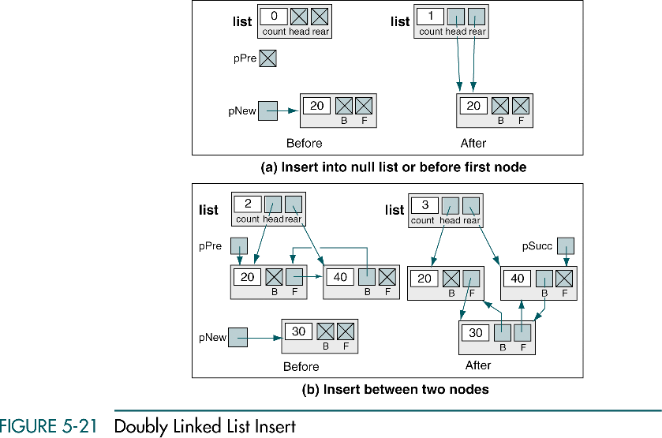

Slide 52
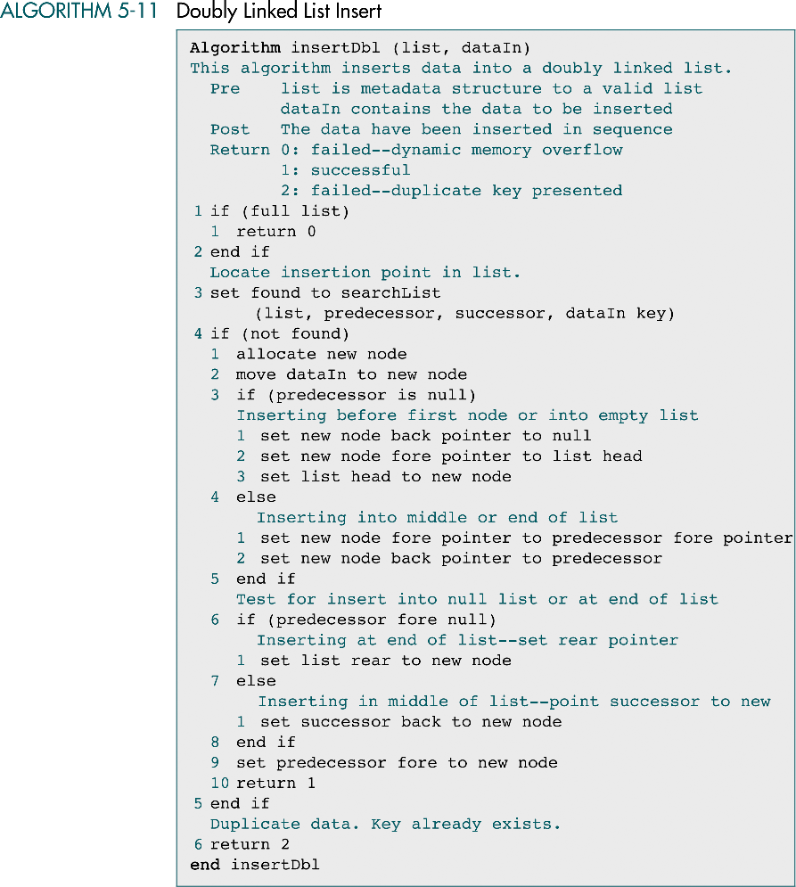

Slide 53
(continued)

Slide 54
